Slide 1
Object Recognition and Detection
Presenting by:
Sathwik kuchana
MS Artificial Intelligence
Yeshiva University New York

Slide 2
outline
Problem statement
Introduction
References
Literature Review

Slide 3

Problem statement
Consider an image containing objects of multiple classes
How can we classify the image into multiple classes?
How can we predict exact location of the object and draw bounding box?
How can we do it accurately and faster?

Slide 4
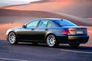
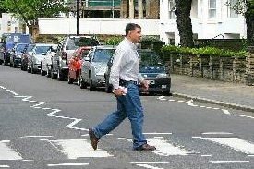
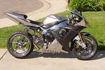
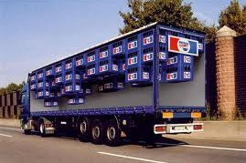
Introduction
Object Recognition
Multi class classification

Slide 5


Slide 6
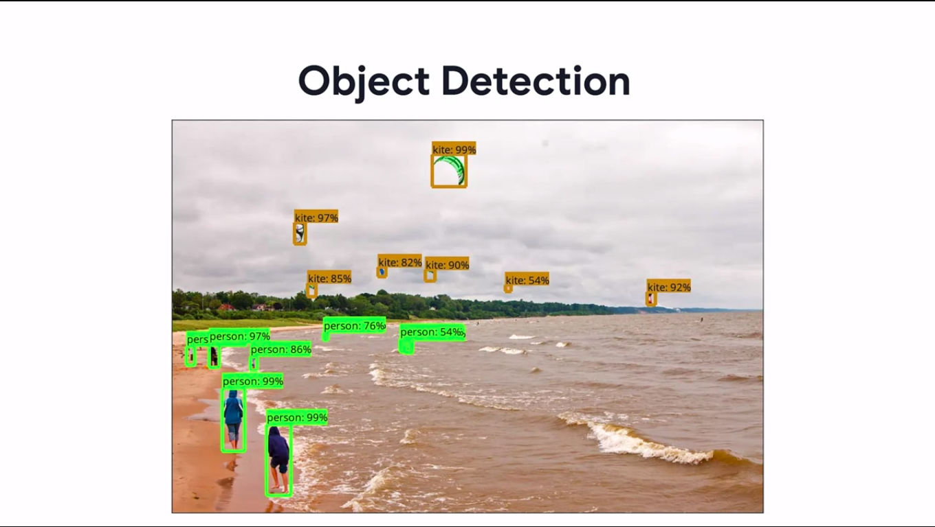

Slide 7
Literature Review
[1] Shaukat Hayat, She Kun, Zuo Tengtao, Yue Yu, Tianyi Tu, Yantong Du .A Deep Learning Framework Using Convolutional Neural Network for Multi-class Object Recognition. 2018 3rd IEEE International Conference on Image, Vision and Computing
[2] Santosh Giri and Basanta Joshi.Transfer Learning Based Image Visualization using CNN.International Journal of Artificial Intelligence and Applications (IJAIA), Vol.10,No.4, July 2019
[3] Rich feature hierarchies for accurate object detection and semantic segmentation Tech report(v5)
[4] Fast R-CNN Ross Girshick Microsoft Research rbg@microsoft.com
[5] Faster R-CNN: Towards Real-Time Object Detection with Region Proposal Networks

Slide 8
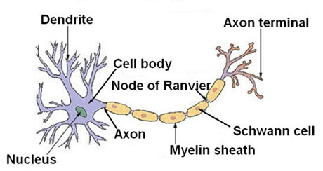
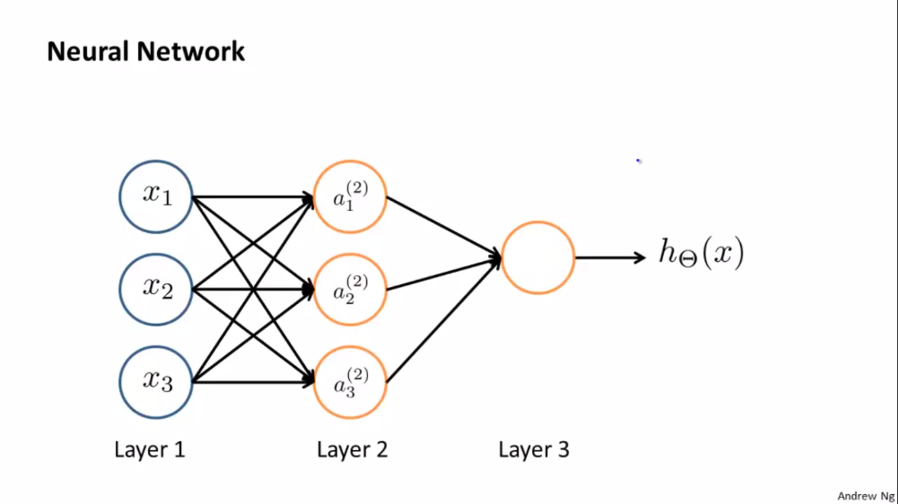
Neural Networks

Slide 9
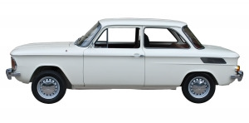
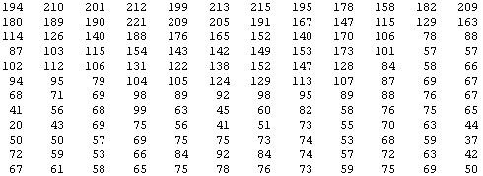
Why Convolutional Neural Networks?
You see this:
But the camera sees this:

Slide 10
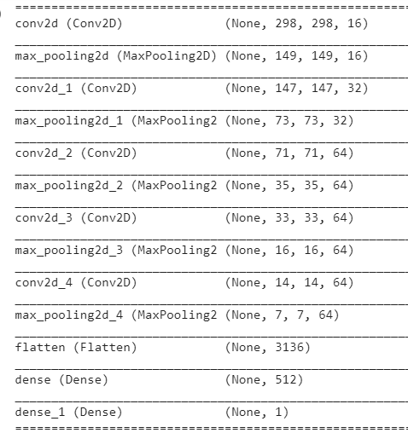
300 x 300 pixel images→90,000 pixels

Slide 11
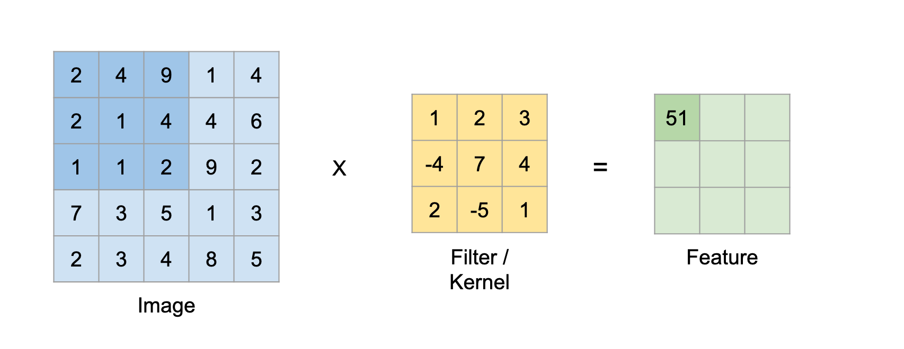
Convolutions

Slide 12
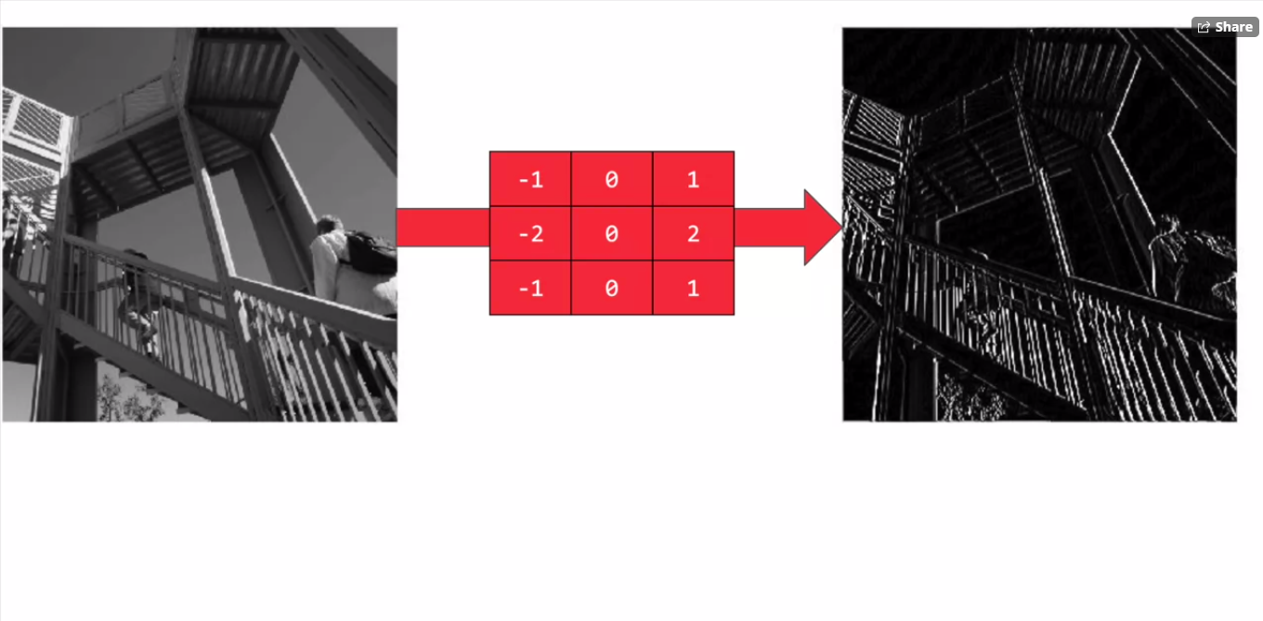

Slide 13
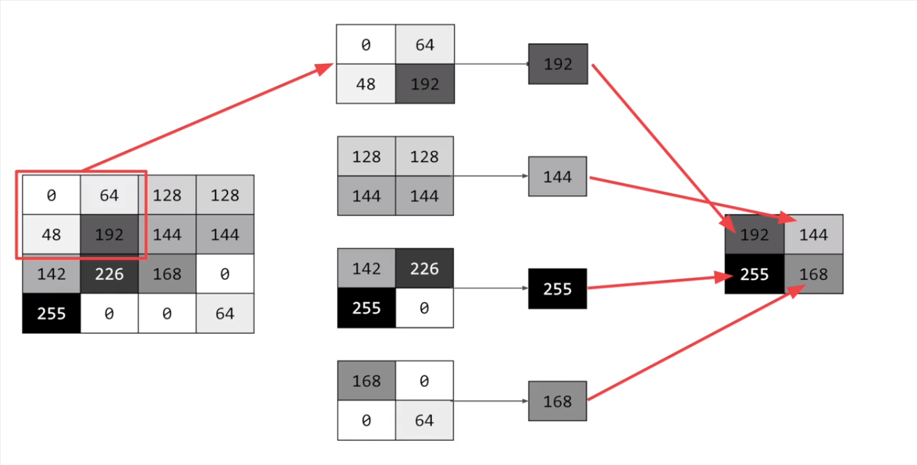
pooling

Slide 14
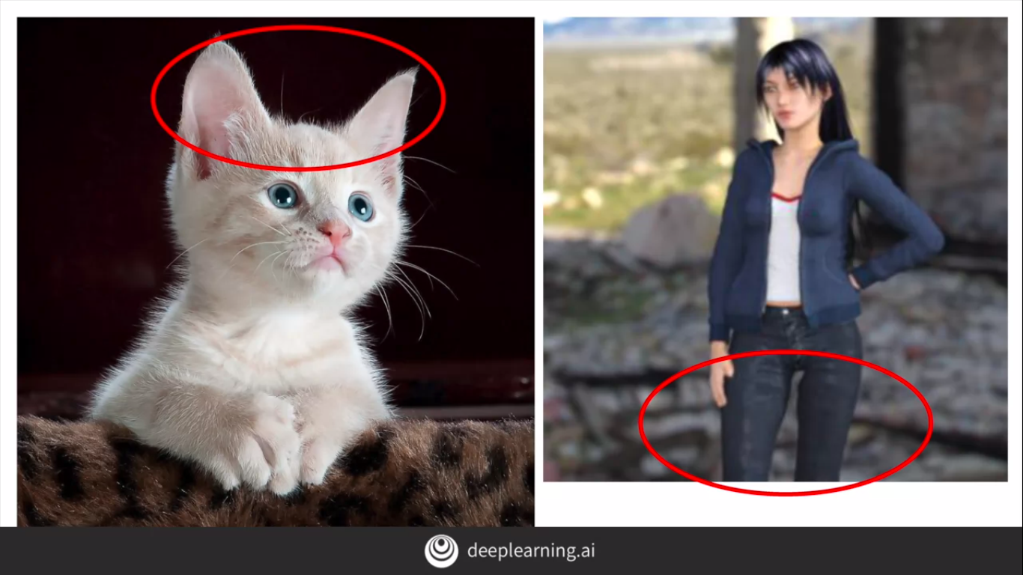
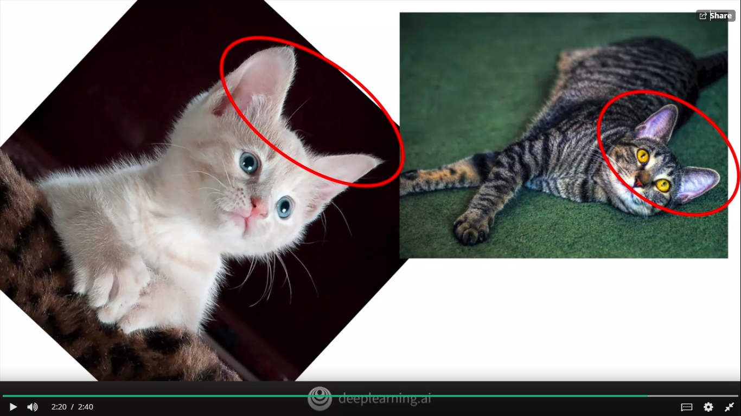
Data Augmentation

Slide 15
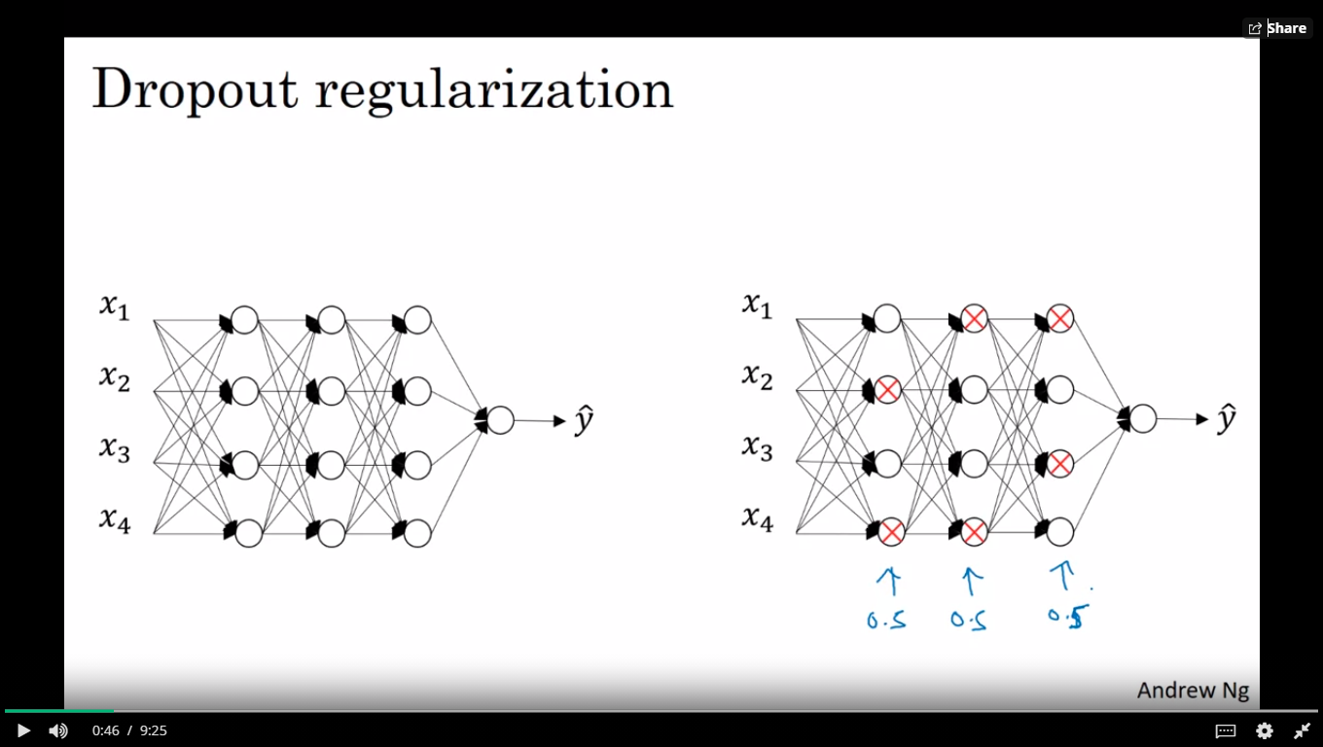
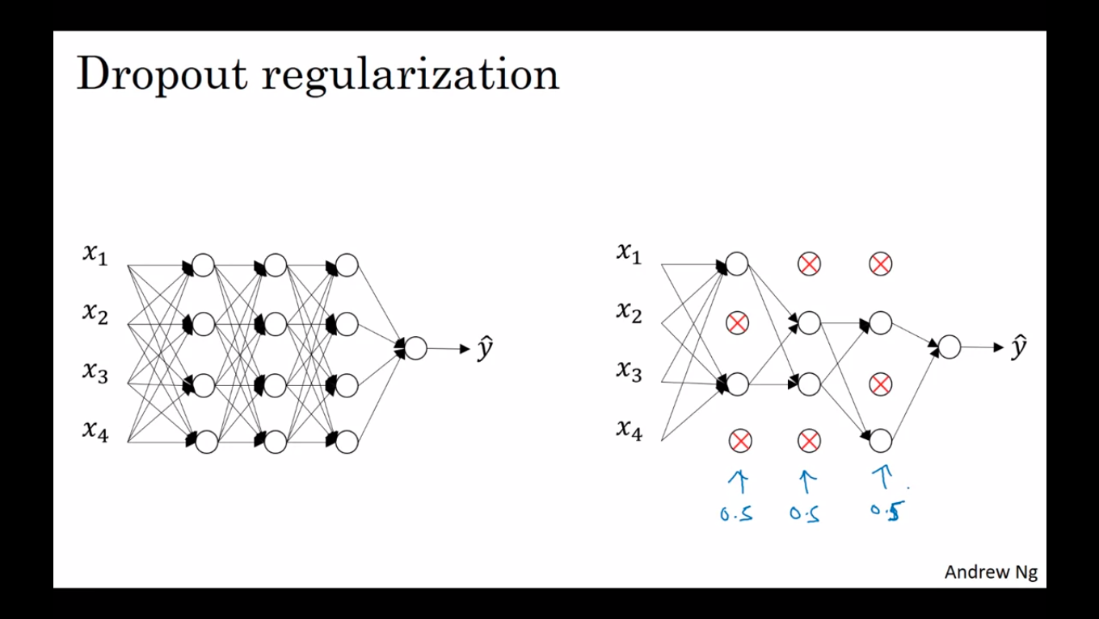
Dropout

Slide 16
Steps:
1.preprocessing :- removing any corrupt image by checking size of the file
2.Train/validation set split: using split_size
3.Image labels: using Image Data Generator (rescaling, Data Augmentation)
4.Adding convolutions and pooling
5.Adding Dropout : Regularization Technique to prevent overfitting
6.validation:

Slide 17
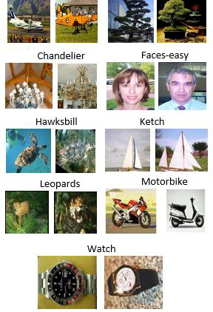
Airplanes Bonsai
Dataset : Caltech -101
Object_Category​ | Total Images​ | No :Train/Validation
Airplanes​ | 800​ | 100/20​
Bonsai​ | 128​ | 100/20
Chandelier​ | 107​ | 100/7​
Faces_Easy​ | 435​ | 100/20
Hawksbill​ | 104​ | 100/4
Ketch​ | 114​ | 100/14
Leopard​ | 200​ | 100/20
Motorbikes​ | 798​ | 100/20​
Watch​ | 239​ | 100/240
Total Train /Validation | ​1045 | 900/145​

Slide 18
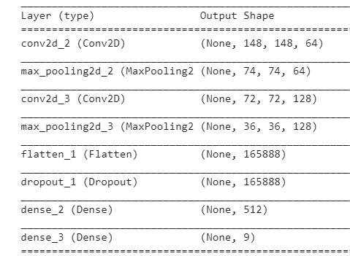
Network Architecture
optimizer | Adam
loss | categorical_crossentropy
Regularization | Dropout,Data Augmentation
Activation functions | Relu and softmax

Slide 19
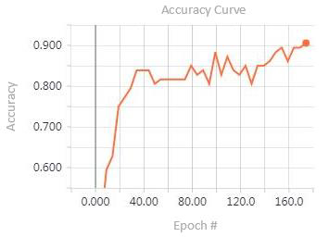
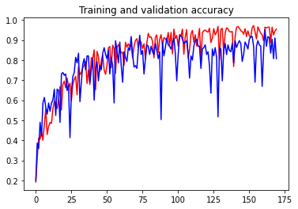
Models | Validation accuracy
Research paper[1] | 90.12%
Our model | 95.17%

Slide 20
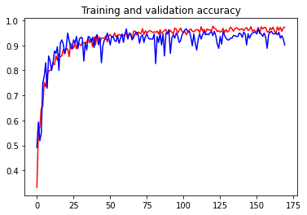
Split size =0.9 Training set = 90% validation set = 10%
Object_Category​ | Total Images​ | No :Train/Validation
Airplanes​ | 800​ | 720/80
Bonsai​ | 128​ | 115/13
Chandelier​ | 107​ | 96/11
Faces_Easy​ | 435​ | 391/44
Hawksbill​ | 104​ | 93/11
Ketch​ | 114​ | 102/12
Leopard​ | 200​ | 180/20
Motorbikes​ | 798​ | 718/80
Watch​ | 239​ | 215/24
Total Train /Validation | ​2925 | 2630/295
validation accuracy = 95%

Slide 21
Two Stages of Object Detection
1.Region proposal
(i) sliding window
(ii) selective search
2.Object Detection and classification

Slide 22
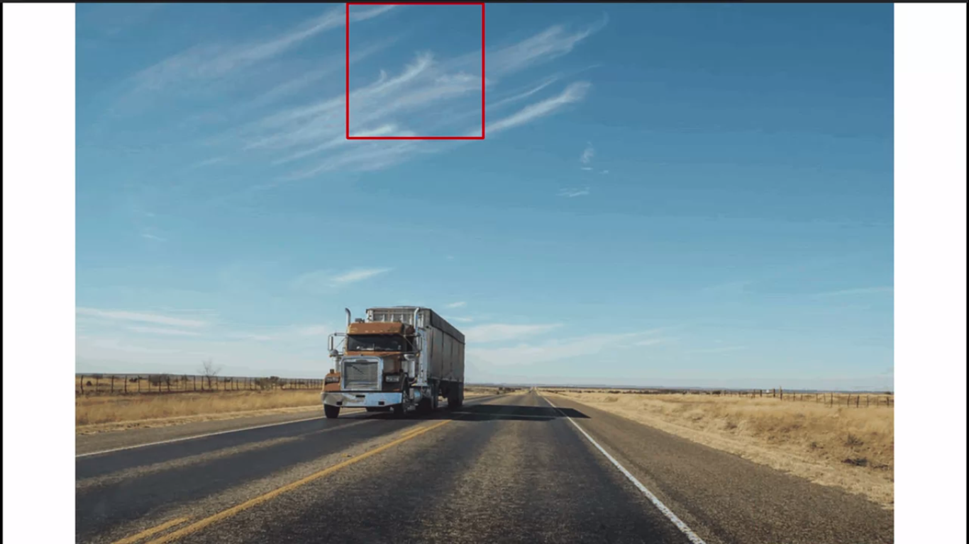
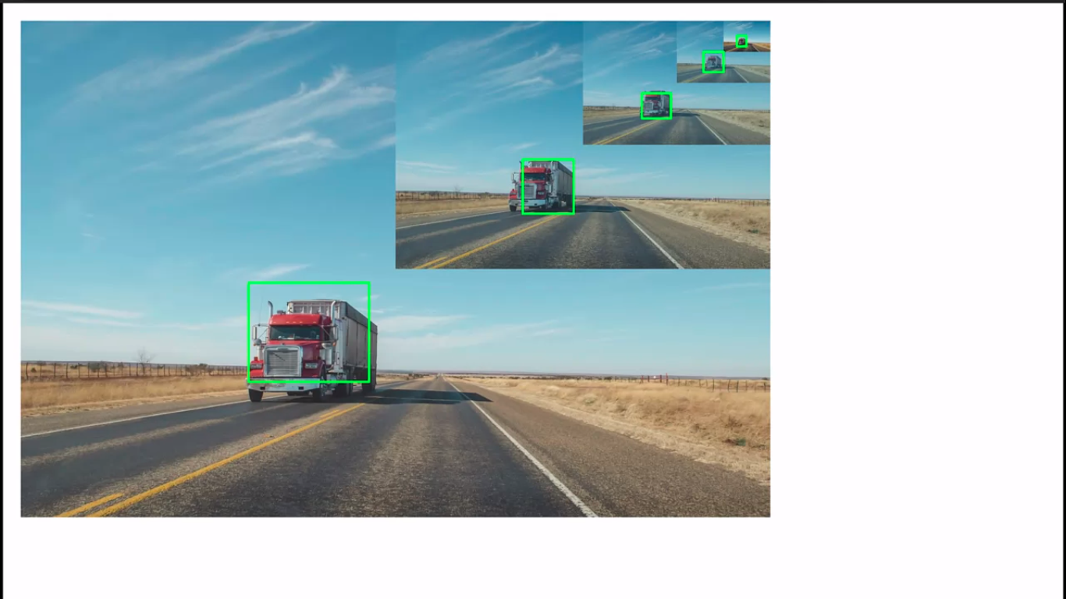
Sliding window

Slide 23
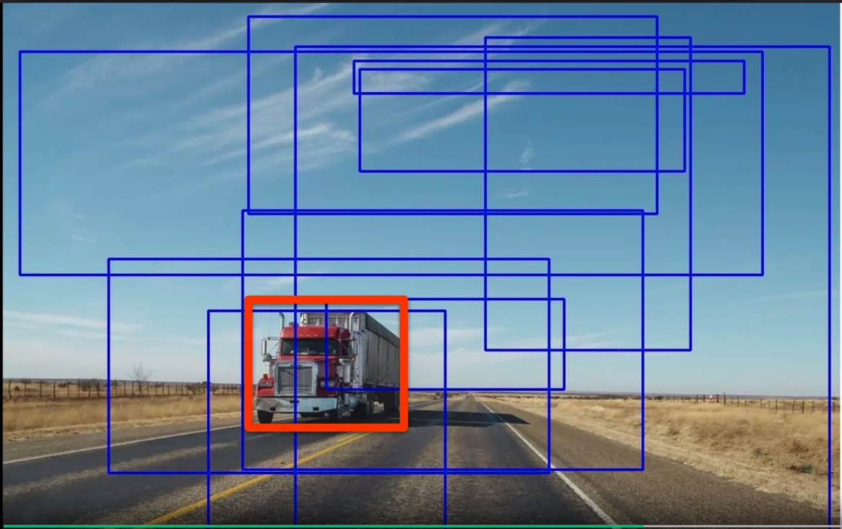
Selective search

Slide 24
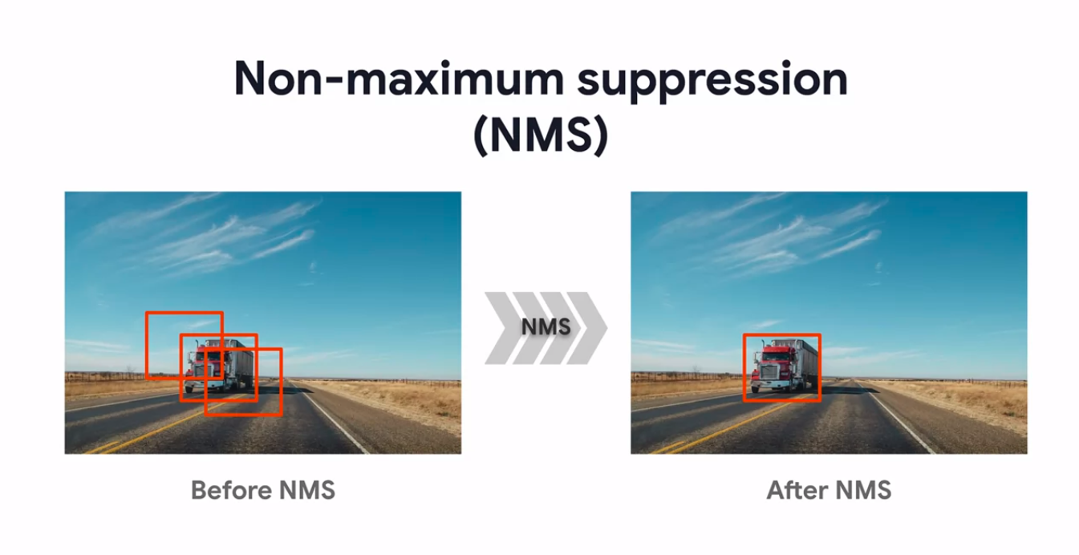

Slide 25
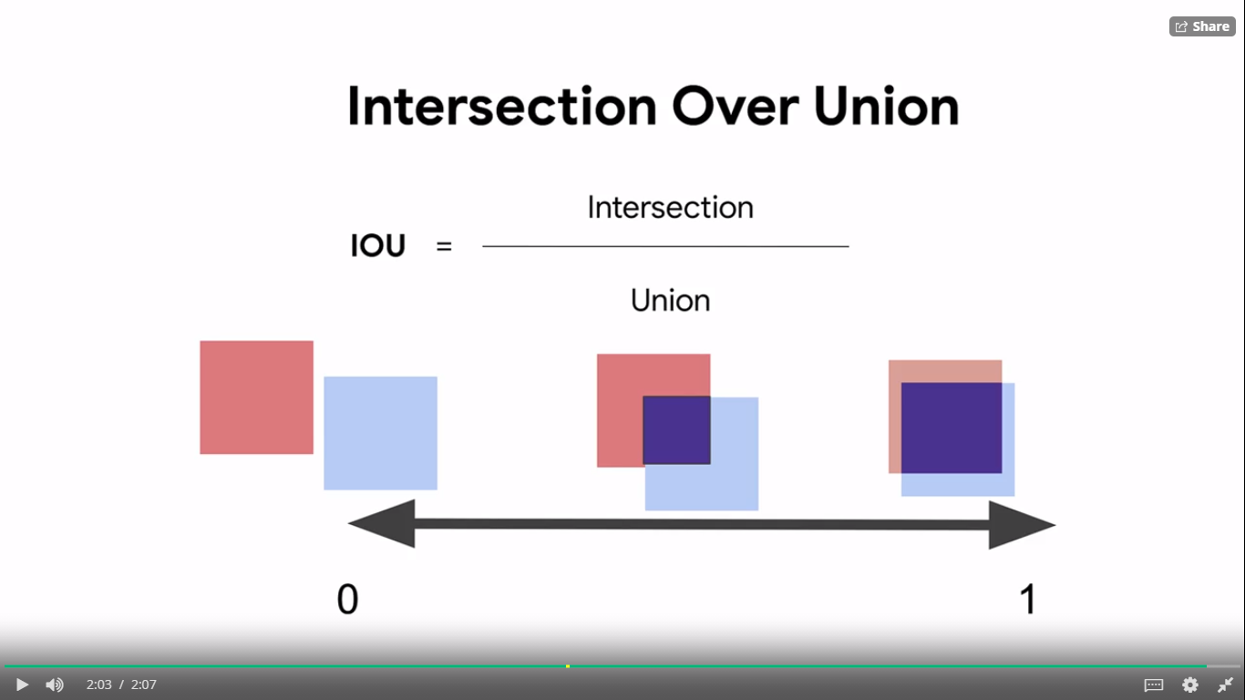

Slide 26
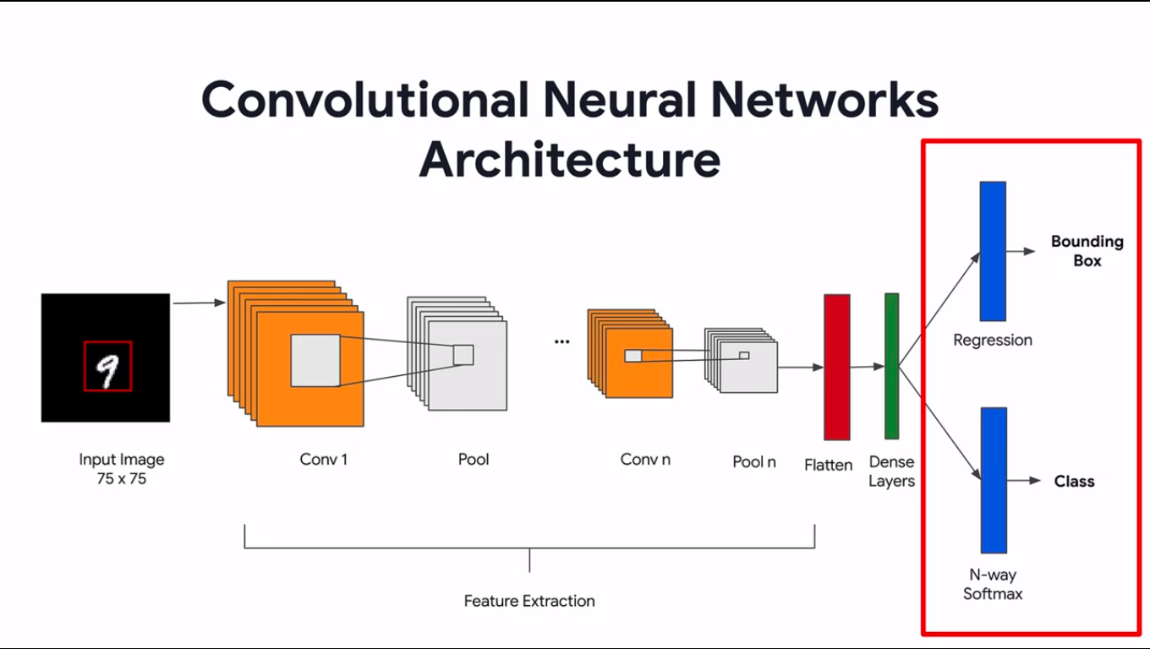

Slide 27
MNIST –Dataset
Total images = 70,000
Size = 28 x 28
Number of classes = 10 (0-9)
Training Data -60,000
Validation Data-10,000

Slide 28
Steps
Data preprocessing
Data Visualization
Define the Network
Training &validation
Model Evaluation

Slide 29
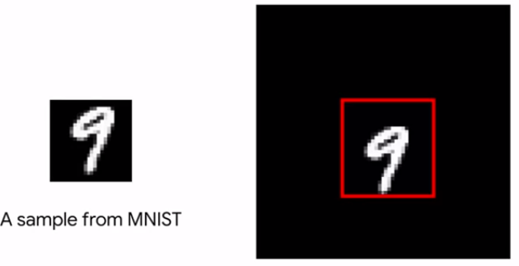
1.Data Preprocessing
using the MNIST dataset to synthesize a custom dataset for the task:
Place each "digit" image on a black canvas of width 75 x 75 at random locations.
Calculate the corresponding bounding boxes for those "digits".
getting training data and validation data

Slide 30
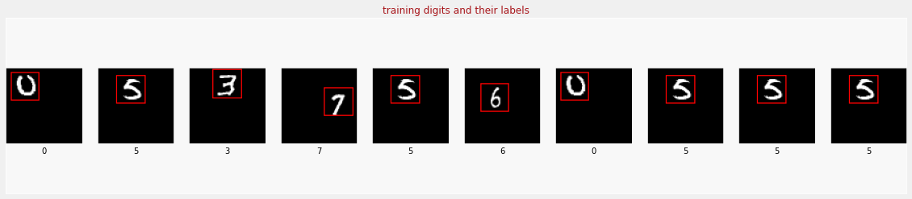
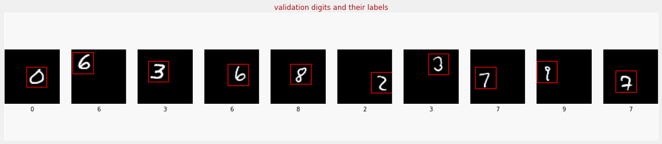
2.Data Visualization

Slide 31
3. Define the network
Feature extractor: these convolutional layers extract the features of the image.
classifier: This define the output layer that predicts among 10 categories (digits 0 through 9)
Bounding box regression: This defines the output layer that predicts 4 numeric values, which define the coordinates of the bounding box (xmin, ymin, xmax, ymax)
Final model: This combines the layers for feature extraction, classification and bounding box prediction.
Define and compile model: choose the optimizer and metrics, then compile the model.

Slide 32
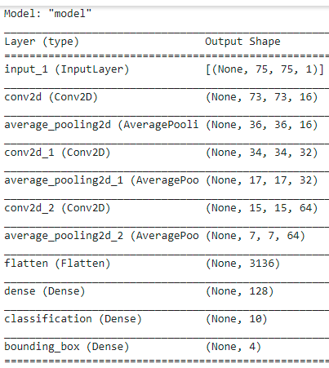
Network Architecture
Optimizer = Adam
Loss = ‘categorical cross entropy’

Slide 33
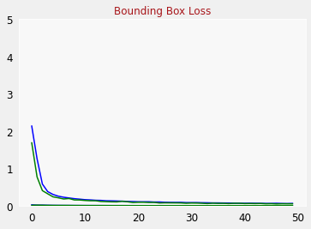
4.Training and Validation
Classification loss: 0.0497
Classification accuracy: 0.9829
Validation accuracy: 0.9828999638557434
Bounding box mse: 9.2932e-04
----- classification loss
------Bounding box loss

Slide 34
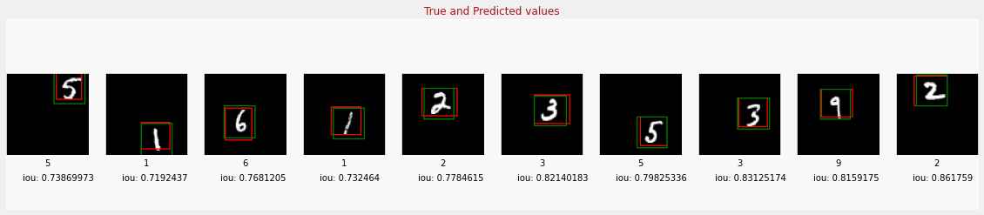
5.Model Evaluation
Calculate the I-O-U metric to evaluate the model's performance.
Iou threshold = 0.6
Number of predictions where Iou > threshold(0.6): 9615
Number of predictions where Iou < threshold(0.6): 385
mIOU = 0.77

Slide 35
Object Detection models results comparison
Dataset:
MNIST hand written digits
Total training images: 60,000
Total validation images: 10,000
Size = 28 x 28

Slide 36
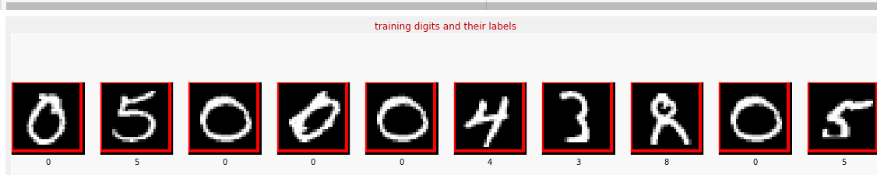
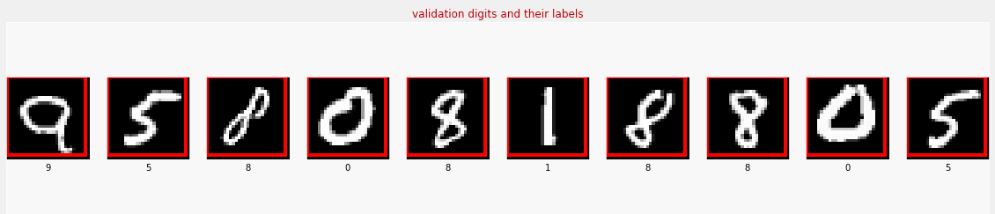
Sample Training Images
Sample Validation Images

Slide 37
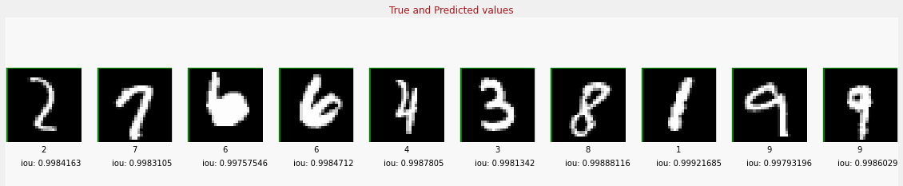
Result Images

Slide 38
IOU Comparison
Models | Number of epochs | mIOU
CNN Model | 50 | 0.930
 | 100 | 0.957
 | 500 | 0.968
 | 1000 | 0.98
 | 1500 | 0.997
 | 2000 | 0.998
Faster-RCNN [6] | NA | 0.991

Slide 39
Object detection models
1.Ssd + Mobilenet V2
2. FasterRCNN + InceptionResNet V2:
model | Inference time(in sec) | Accuracy
Ssd+mobilenet v2 | 33.33 | Less Accurate
FasterRCNN+InceptionResNet V2 | 28.94 | More Accurate

Slide 40
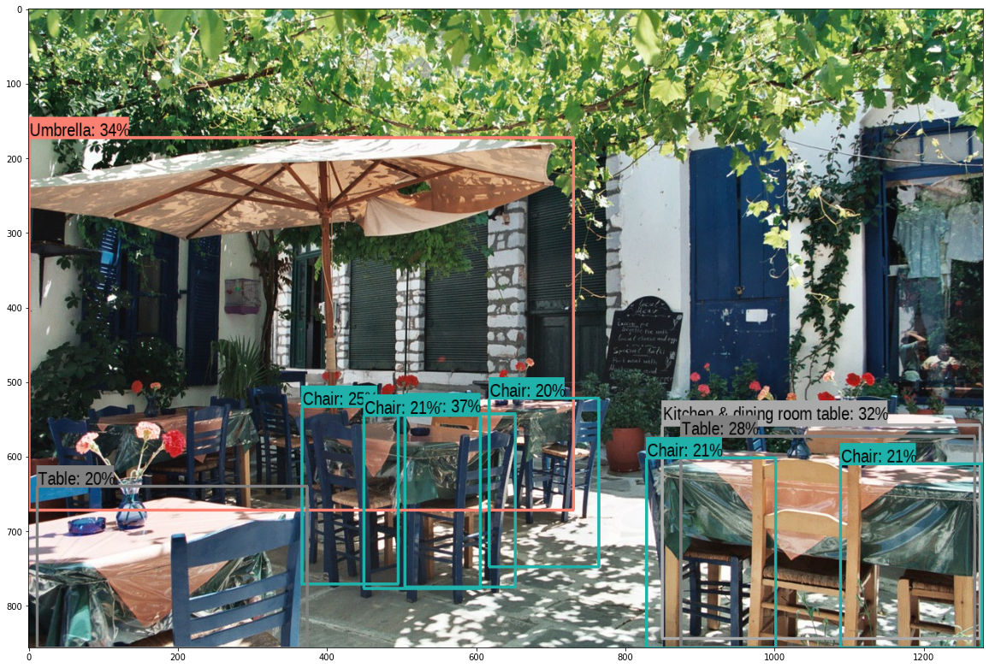
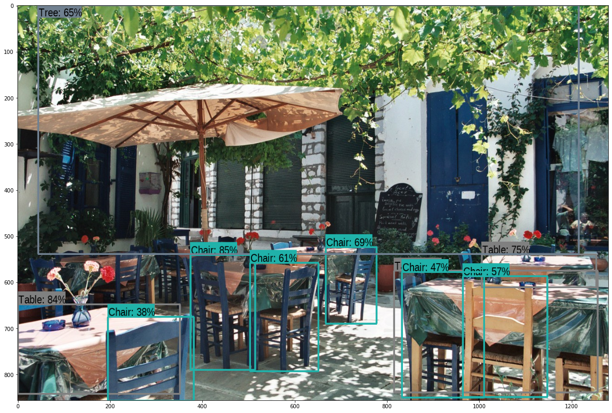
ssd + mobilenet V2
FasterRCNN + InceptionResNet V2:

Slide 41
conclusion
1. In object recognition model we performed it on Caltech -101 Dataset. In this we have used a simple CNN and tried out different optimizers, batch sizes and also used different learning rates and finally got an impressive accuracy of 95.17% which is greater when compare to the literature published in research paper [1].
2. Coming to the object localization task we performed it on MNIST hand written digits dataset. In this we have used a simple CNN with regression and SoftMax layers in the output and accomplished the task and also, we have calculated the mean IOU for evaluating the model’s performance and we have achieved a mean IOU of 0.998 for the validation set which is highest when compared to the results with the literature published in the research paper [6].

Slide 42
Future Work
We can further improve the accuracy of these models by using CAM(class activation map)

Slide 43
Learned Skills
Machine learning by Andrew Ng.coursera
Introduction to TensorFlow for AI,ML and DL by Laurence Moroney.coursera
Convolutional Neural Networks in TensorFlow by Laurance Moroney.coursera
Advance Computer vision with TensorFlow by Laurence Moroney.coursera

Slide 44
References
[1] Shaukat Hayat, She Kun, Zuo Tengtao, Yue Yu, Tianyi Tu, Yantong Du .A Deep Learning Framework Using Convolutional Neural Network for Multi-class Object Recognition. 2018 3rd IEEE International Conference on Image, Vision and Computing
[2] Santosh Giri and Basanta Joshi.Transfer Learning Based Image Visualization using CNN.International Journal of Artificial Intelligence and Applications (IJAIA), Vol.10,No.4, July 2019
[3] Rich feature hierarchies for accurate object detection and semantic segmentation Tech report(v5)
[4] Fast R-CNN Ross Girshick Microsoft Research rbg@microsoft.com
[5] Faster R-CNN: Towards Real-Time Object Detection with Region Proposal Networks

Slide 45
References
[6] An improved faster‐RCNN model for handwritten character recognition Saleh Albahli1 Marriam Nawaz, Ali Javed2,3 · Aun Irtaza
Advance Computer vision with TensorFlow by Laurence Moroney.coursera
https://medium.com/@RaghavPrabhu/understanding-of-convolutional-neural-networkcnndeep-learning-99760835f148
https://www.kdnuggets.com/2020/02/deep-neural-networks.html
https://www.coursera.org/learn/introduction-tensorflow/lecture/JSKji/what-areconvolutions-and-pooling
https://medium.com/@danqing/a-practical-guide-to-relu-b83ca804f1f7
https://machinelearningmastery.com/object-recognition-with-deep-learning/
https://www.coursera.org/learn/advanced-computer-vision-withtensorflow/lecture/088bZ/object-detection-and-sliding-windows
https://www.coursera.org/learn/introduction-tensorflow/home/week/

Slide 46
Thank you

